Slide 1
Office Automation Tools
Unit-II Word Processing: Formatting Text, Pages, Lists, Tables

Slide 2
M S Word
Microsoft Word is a widely used commercial word processor designed by Microsoft. It is a paid software that helps in preparing, editing, storing and printing documents quickly and with accuracy.
MS Word is a part of the Microsoft Office suite, a productivity software and can also be purchased as a stand-alone product. It was initially launched in 1983 and has been revised numerous times since then. MS Word is available on both Windows and Macintosh operating systems.

Slide 3
M S Word
A word processor lets a user change words or phrases, move whole sections of text from one place to another, store blocks of text, align margins.
Use of MS Word has changed the look and feel of official correspondence, reports, and proposals etc. to a great extent.
The powerful features of Word supports to creation of graphic based multicolumn publications such as Fliers, Newsletters and Internet web pages.

Slide 4
M S Word
MS Word offers several features to ease document creation and editing including:
WYSIWYG (what-you-see-is-what-you-get) display: It ensures that everything you see on screen will appear the same way when printed or moved to another format or program.
Proof Reading – Spelling and Grammar check: Word comes with a built-in dictionary for spell checking; misspelled words are marked with a red underline.
Text-level features such as bold, underline, italic and strike-through
Page-level features such as indentation, paragraphing and justification.

Slide 5
M S Word
Word Wrapping
Selecting a block of Text Copy, Move, Paste and Cut Text
Search And Replace Text
Margin and Colum Settings
Character Formatting and Styling
External support: Word is compatible with many other programs, the most common being the other members of the Office suite

Slide 6
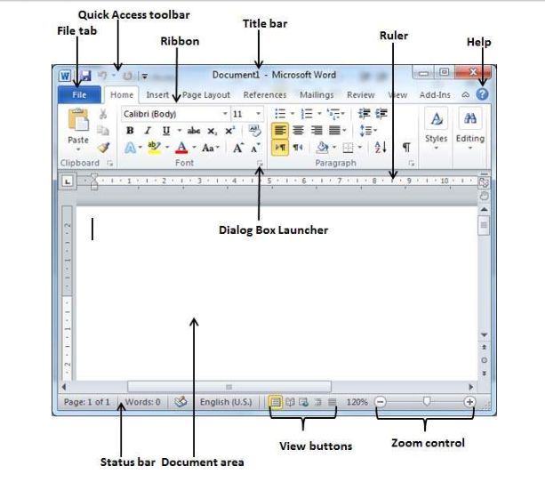
Various Parts in M S Word Window

Slide 7
Various Parts in M S Word Window
File Tab
    The File tab replaces the Office button from Word 2007. You can click it to check the Backstage view. This is where you come when you need to open or save files, create new documents, print a document, and do other file-related operations.
Quick Access Toolbar
    This you will find just above the File tab. This is a convenient resting place for the most frequently used commands in Word. You can customize this toolbar based on your comfort.

Slide 8
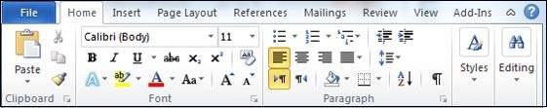
Various Parts in M S Word Window
Ribbon
  Ribbon contains commands organized in three components:
    Tabs − These appear across the top of the Ribbon and contain groups of related commands. Home, Insert, Page Layout are examples of ribbon tabs.
    Groups − They organize related commands; each group name appears below the group on the Ribbon. For example, group of commands related to fonts or group of commands related to alignment, etc.
    Commands − Commands appear within each group as mentioned above.

Slide 9
Various Parts in M S Word Window
Document Area
    This is the area where you type. The flashing vertical bar is called the insertion point and it represents the location where text will appear when you type.
Status Bar
    This displays the document information as well as the insertion point location. From left to right, this bar contains the total number of pages and words in the document, language, etc.
    You can configure the status bar by right-clicking anywhere on it and by selecting or deselecting options from the provided list.
Dialog Box Launcher
    This appears as very small arrow in the lower-right corner of many groups on the Ribbon. Clicking this button opens a dialog box or task pane that provides more options about the group.

Slide 10
FORMATTING TEXT
Formatting refers to the way our text will look like – the design of the characters, their size, the space between paragraphs, their alignment, etc.
First, selection of text.
  By using the mouse, position the insertion point (by clicking the mouse) at the beginning or end of the block to be selected and then click and drag to the end or beginning of the block.

Slide 11
FORMATTING TEXT
By using the shortcuts:
  Double-click on a word to select it.
  Triple-click on a paragraph to select it.
  Ctrl+click on a sentence to select it.
There are basically two types of formatting:
  • Character formatting, and
  • Paragraph formatting

Slide 12
CHARACTER FORMATTING
Character formatting is the one which we can apply to any individual character or to a group of characters. It has the following options:
  Font : This decides the appearance of our characters.
  Font Style : We can make characters stand out by making them Bold, Italic or both.
  Size : This increases/decreases the size of the characters – the size measured in points (72 points =1 inch)
  Font Color : We can apply colours to the characters for printing the final document

Slide 13
CHARACTER FORMATTING
Underline : We can draw attention to some particular text by underlining it.
Effects : We can also apply effects to our text. Two most common ones are Superscript and Subscript. The 2 in 3 2 is a superscript. To make a character into superscript, we need to select only that character, and click the box against Superscript. Similarly, 1 in T1 is a subscript.

Slide 14
PARAGRAPH FORMATTING
There are some formatting features that get applied to an entire paragraph or paragraphs, but not to any given character or a group thereof. Such formatting features are described as Paragraph formatting.
It provides the following options:
  Alignment : The alignment of a paragraph may be left, center, right or justify

Slide 15
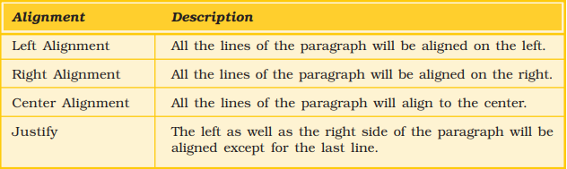
PARAGRAPH FORMATTING
  Indentation : Indents are the left and right boundaries of selected paragraphs within a document. This may b e necessary when different paragraphs have different left and right boundaries. For example, we can see the indentation in poems. The indentation options available in most word processors are Left and Right. Apart from these, we can have special indentation in the form of First Line and Hanging.

Slide 16
Indent
There are several options for indenting:
  First Line: Controls the left boundary for the first line of a paragraph
  Hanging: Controls the left boundary of every line in a paragraph except the first one
  Left: Controls the left boundary for every line in a paragraph
  Right: Controls the right boundary for every line in a paragraph

Slide 17
PARAGRAPH FORMATTING
  Spacing : This option allows us to have some space before and/or after a paragraph or a group of paragraphs. We can select the paragraph(s) and select or type in the desired value against the appropriate option – Before or After. These values are measured in points.
  There is also a Line spacing option, which decides on the spacing between the lines of the paragraph. Normally we will type with the value Single for it. But if we want to have more space between the lines, we can select 1.5 lines or Double for it.

Slide 18
TO ADD BULLETS OR NUMBERING
Bullets are small dots, squares, dashes or graphics that are often seen before the text (word, line, sentence, paragraph or any other object). To add bullets,
  Select the object
  Click on Bullets and Numbering from Format menu to open the Bullets and Numbering dialog box
  Click on the bullet of your choice, and click OK.

Slide 19
TO ADD BULLETS OR NUMBERING
Instead of a bullet, a number may also precede a group of paragaphs. To do so, proceed as follows:
  Choose the numbered tab from Bullets and Numbering of Format menu to view the numbering options.
  Select the numbering option of choice, and click OK.

Slide 20
Views in MS Word
Most word processors provide us multiple views: we can select the one that suits the work at hand. We can display our document in one of the five views: Normal layout, Web Layout, Print Layout, Reading Layout or Online Layout.

Slide 21
Views in MS Word
Normal Layout: Normal layout view shows formatting such as line spacing, font, point size and italics.
Web Layout: Web layout view enables us to view our document as it would appear in a web browser such as the Internet Explorer.
Print Layout The Print Layout view shows how the document will look when it is printed.

Slide 22
Views in MS Word
Reading Layout: Reading Layout view formats our screen to make reading our document more comfortable.
Outline Layout: Outline view displays the document in outline form. Only headings can be displayed hiding the text under them. We can just move a heading; the accompanying text will automatically move with it.

Slide 23
Create a table
Tables provide a neat way to present complex information in vertical columns and horizontal rows of cells. Each cell can contain text – a single paragraph or multiple paragraphs – or graphics. To insert a table:
  click on Insert in the Table menu and select on Table from resulting menu.
  This opens up the Insert Table dialog box . Type in some value for the number of columns and rows… let us type in the values 5 and 4 respectively.

Slide 24
Create a table
We can now see this table on the page – with 5 columns and 4 rows.
We can move the insertion point from one cell to another by clicking the mouse at the desired cell. We can also press the Tab key to move to the next cell, or Shift+Tab keys to move to the previous one.

Slide 25
Mail Merge
Mail merge is a feature that enables users to send a similar letter or document to multiple recipients. It enables connecting a single form template with a data source that contains information about the recipient’s name, address and other predefined and supported data.

Slide 26
The main uses of Word’s Mail Merge features are:
You can merge a list of names and addresses to a single letter that can be sent to different people in their names and addresses.
You can create categories, a single letter with variable information fields in it, or labels.
You can also produce merged documents such as directory lists, invoices, print address lists, or print addresses on envelopes and mailing labels.

Slide 27
TYPES OF DOCUMENTS IN MAIL MERGE
Mail Merge requires three types of documents:
Main Document: In a Mail Merge operation, the personalized document (such as, a standard letter, or envelope, or mailing label) is known as the main document. It is the document containing the text and graphics that stay the same for each version of the merged document - for example, the return address and body of a form letter.

Slide 28
TYPES OF DOCUMENTS IN MAIL MERGE
2. Data Source: Data source is a file that contains the names and addresses or any other information that vary with each version of a mail-merge document. For example, a list of names and addresses for a form letter you want to send to a list of clients or other people.

Slide 29
TYPES OF DOCUMENTS IN MAIL MERGE
3. Merge Document: When you merge the main document with data source, a third document called merge document will be produced.
The merge document can be merged to the screen to view letters along with addresses; or directly to the printer to print the letters along with addresses and print addresses on envelopes or labels; or save as some other file that can be used later for printing. Inserting the data or information from the data source in the main document creates the merge document.

Slide 30
Templates
A template is a predesigned document you can use to create new documents with the same formatting. With a template, many of the more important document design decisions such as margin size, font style and size, and spacing are predetermined.
In MS Word, documents are usually based on Normal Template(normal.dotx).
MS Words displays a number of templates like Equity Fax, Report, Letter etc. You can select any one of those according to your requirement and open it by clicking create button for new document making.

Slide 31
Wildcard Searching
A wildcard allows you to search for variable text i.e. using wildcards, you can find words in your Word documents that you know only a part of, or a group of words with similar letters.
two basic wildcard characters, ? and *, where ? represents any single letter, and * represents a group of letters.

Slide 32
Wildcard Searching
To search for a character as a wildcard, type a backslash (\) before the character.
The question mark (?) wildcard represents any single character. for example 'b?t' finds bat, bet, bit, and but
The asterisk (*) wildcard represents a string of characters. for example 'b*t' finds bit, boat, and burnt

Slide 33
Proofing/ Spelling and Grammar Check
Proofing means reading each word (and punctuation mark) in a document slowly and carefully while looking for errors i.e. Careful reading of a document, to detect any errors in spelling, punctuation, or grammar.
Word provides you with several proofing features that will help you produce professional, error-free documents.

Slide 34
spelling and grammar
By default, Word automatically checks your document for spelling and grammar errors. These errors are indicated by colored wavy lines.
The blue line indicates a contextual spelling error.
  A contextual spelling error is when an incorrect spelling of a word is chosen. For example, if you write Deer Mr. Theodore at the beginning of a letter, deer is a contextual spelling error because dear should have been used. Deer is spelled correctly, but it is used incorrectly in this letter.
The red line indicates a misspelled word.
The green line indicates a grammatical error.

